Slide 1
Software Quality Engineering
Lecture 1
Part IV-QUANTIFIABLE QUALITY IMPROVEMENT
Quality models and measurements, SCM
alina.arshad@nu.edu.pk

Slide 2
Today’s Outline
Analysis → Feedback loop→ Follow-up
Quality models and measurements
Types of Quality Assessment Models.
Comparing Quality Assessment Models.
Data Requirements and Measurement
Measurement and Model Selection.
Software Configuration Management (SCM)
Why SCM?
SCM concepts and Terminology
Software Configuration Management Activities
Change Management
Build and Release Management
System Release
Revision
Notes:
Chapter 14 SQA by Jeff Tian

Slide 3
Quality measurement
The primary purpose of the measurement and analysis activities is to provide feedback and useful information to manage software quality, the quality engineering process, and the overall software development/maintenance process and activities.
The feedback and information provided are based on the analysis results using various models on the data collected from the quality assurance (QA) and the general development activities.

Slide 4
QA Data and Analysis
Generic testing process:
Test planning and preparation.
Execution and measurement.
Other QA activities:
Similar general process.
Data from QA/other sources
Models used in analysis and follow-up:
provide timely feedback/assessment
prediction, anticipating/planning

Slide 5
QA Models and Measures
General approach
Adapt GQM-paradigm.
Quality: basic concept and ideas.
Compare models ⇒ taxonomy.
Quality attributes and definitions:
Q models: data ⇒ quality
Correctness vs. other attributes
Our definition/restriction: being defect-free or of low-defect
Notes:
Goal question metric

Slide 6
Quality Analysis
Analysis and modeling:
Quality models: data ⇒ quality
a.k.a. quality assessment models or quality evaluation models
Various models needed for .
Assessment, prediction, control
Management decisions
Problematic areas for actions
Process improvement
Measurement data needed
Direct quality measurements: success/failure (& defect info)
Indirect quality measurements:– activities/internal/environmental. Indirect but early quality indicators.

Slide 7
Quality Models
Practical issues:
Applicability vs. appl. environment
Goal/Usefulness: information/results?
Data: measurement data required
Cost of models and related data
Type of quality models
Generalized: averages or trends
Product-specific: more customized
Relating to issues above

Slide 8
MODELS FOR QUALITY ASSESSMENT
Quality assessment models are analytical models that provide quantitative assessment of selected quality characteristics or sub-characteristics based on measurement data from software projects.
Such models can help us obtain an objective assessment of our current product quality, in contrast to the often-unreliable subjective assessment based on personal judgment or imprecise qualitative assessment.
When applied over time, these models can provide us with an accurate prediction of the future quality, which can be used to help us make project scheduling, resource allocation, and other management decisions.

Slide 9
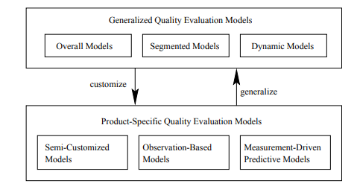
Generalized Models: Overall
Model taxonomy:
Generalized:
overall, segmented, and dynamic
Product-specific:
semi-customized: product history
observation-based: observations
measurement-driven: predictive

Slide 10
Generalized Models: Overall
Key characteristics
Industrial averages/patterns: ⇒ (single) rough estimate.
Most widely applicable.
Low cost of use.
Examples: Defect density.
Estimate total defect with sizing model.
(counting in-field unique defect only)
Non-quantitative overall models:
As extension to quantitative models.
Examples: 80:20 rule, and other general observations.
Notes:
Overall quality models are the most general subtype of generalized quality models, which provide a rough estimate of product quality without requiring any product specific measurement or even a general characterization of the product segment.

Slide 11
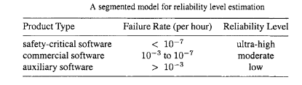
Generalized Models: Segmented
Key characteristics:
Estimates via product segmentation.
Model: segment → quality.
Multiple estimates provided.
Other applications.
Commonly used in software estimation.
Example: COCOMO models.
Notes:
if some general information about the product under study is available, we can use segmented models instead of overall models to get a better quality estimate. Table 19.1 gives another example of segmented models, based on empirical data (Leve- son, 1995; Lyu, 1995a), which estimates reliability levels for different product segments.

Slide 12
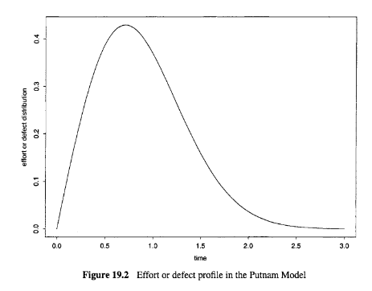
Generalized Models: Dynamic
Example: Putnam model
Rayleigh curve for failure rate: r = 2Bate^{−at2}
Overall/average trend over time.
Often expressed as a mathematical function or an empirical curve.
Combined models possible,
e.g., segmented dynamic models.
Notes:
As a subset of generalized models, the dynamic models provide information about quality over time or development phases. For example, a general profile of defect distribution over different development phases can be considered a quality model of this type.

Slide 13
PRODUCT-SPECIFIC MODELS (Psm)
Product-specific info. Used (vs. none used in generalized models)
Better accuracy/usefulness at cost ↑
Three types:
semi-customized
observation-based
measurement-driven predictive
Connection to generalized models (GMs):
Customize GMs to PSMs with new/refined models and additional data.
Generalize PSMs to GMs with empirical evidence and general patterns.

Slide 14
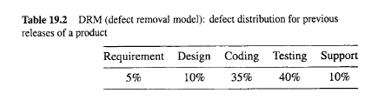
Semi-customized models
Semi-customized models:
Project level model based on history.
Data captured by phase.
Both projections and actual.
Linear extrapolation.
The information from these semi-customized models can be directly used to predict defect distribution for the current release.
Notes:
Related extensions to DRMs:
Defect dynamics model in Ch.20,
ODC defect analyses in Ch.20:
1-way distribution/trend analysis
2-way analysis of interaction.

Slide 15
PSM: Observation-Based
Observation-based models relate observations of the software system behavior to information about related activities to provide more precise quality assessments.
Examples of such models include various software reliability growth models (SRGMs) where observed failures and associated time intervals are fitted to SRGMs to evaluate product reliability.
Focus on the effect/observations
Assumptions about the causes
Assessment-centric
Example: Goel-Okumoto SRGM
functional relation: m(t) = N(1−e ^{−bt})
observed failures over time
curve fitting
reliability assessment/prediction
management decisions: exit criteria

Slide 16
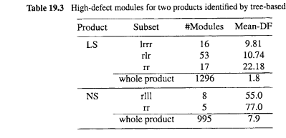
PSM: Predictive
Measurement-driven predictive models
Establish predictive relations between quality and other measurement on the historical data
Provide early prediction of quality and identify problems early so that timely actions can be taken to improve product quality.
Modeling techniques: regression etc.
Risk assessment and management
Model characteristics:
Response: chief concern
Predictors: observable/controllable
Linkage quantification

Slide 17
MODEL COMPARISON AND INTERCONNECTIONS
Different types of quality assessment models and their relations can be compared by looking at their ability to provide useful information, their applicability to different project environments, and their inter-connections.
we can compare the following:
Usefulness of the modeling results, in terms of how accurate the quality estimates are and the applicability of the models to different environments.
Model inter-connections, which can be examined in two opposite directions:
Customization of generalized quality models to provide better quality estimates when product-specific information is available.
Generalization of product-specific models when enough empirical evidence from different products or projects is accumulated.

Slide 18
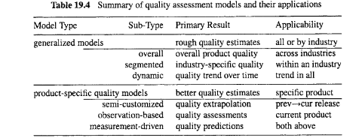
Summary of quality assessment models and their applications
The usefulness of a model mainly depends on two factors:
Is it applicable to the specific development environment and the specific product under development or maintenance?
If so, how accurate the model is in its quality estimates?

Slide 19
MODEL COMPARISON AND INTERCONNECTIONS
This usefulness can be weighted against its cost, in particular, the cost of collecting the required measurement data, which is typically the dominant part of the modeling cost.
Generalized models provide rough quality estimates based on empirical data from industry.
Product-specific models provide more precise quality assessments using product-specific measurements.
However, generalized models are more widely applicable and less expensive to use than product-specific models, because they do not require product-specific measurements.
Consequently, generalized models may be more useful in the product planning stage, and in the early phases of product development, when most product-specific data are unavailable.

Slide 20
MODEL COMPARISON AND INTERCONNECTIONS
One exception to this general rule is when there exist historical data for the previous releases of the current product. Semi-customized models can be used to provide better estimates under this situation.
As development or maintenance activities progress, more measurement data can be collected and various detailed quality models in the category of product-specific models, such as observation-based models and measurement-based predictive models, can be used to better manage the QA activities as well as the overall software development or maintenance processes.

Slide 21
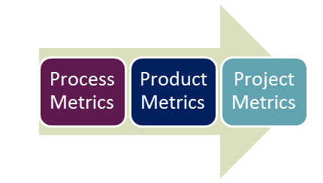
Software Testing Metrics
Software Testing Metrics are the quantitative measures used to estimate the progress, quality, productivity and health of the software testing process.
Metric defines in quantitative terms the degree to which a system, system component, or process possesses a given attribute. E.g. Total number of defects
Product Metrics – describe the characteristics of product e.g., size, complexity, design features, performance, quality level.
Process Metrics – used for improving software development/maintenance process e.g., effectiveness of defect removal, response time of the fix process.
Project Metrics – describe the project characteristics and execution e.g., number of software developers, cost, schedule, productivity.

Slide 22
Test Metrics Glossary
Rework Effort Ratio = (Actual rework efforts spent in that phase/ total actual efforts spent in that phase) X 100
Requirement Creep = ( Total number of requirements added/No of initial requirements)X100
Schedule Variance = (Actual Date of Delivery – Planned Date of Delivery)
Cost of finding a defect in testing = ( Total effort spent on testing/ defects found in testing)
Schedule slippage = (Actual end date – Estimated end date) / (Planned End Date – Planned Start Date) X 100
Passed Test Cases Percentage = (Number of Passed Tests/Total number of tests executed) X 100
Failed Test Cases Percentage = (Number of Failed Tests/Total number of tests executed) X 100
Blocked Test Cases Percentage = (Number of Blocked Tests/Total number of tests executed) X 100
Fixed Defects Percentage = (Defects Fixed/Defects Reported) X 100
Accepted Defects Percentage = (Defects Accepted as Valid by Dev Team /Total Defects Reported) X 100
Defects Deferred Percentage = (Defects deferred for future releases /Total Defects Reported) X 100
Critical Defects Percentage = (Critical Defects / Total Defects Reported) X 100
Average time for a development team to repair defects = (Total time taken for bugfixes/Number of bugs)
Number of tests run per time period = Number of tests run/Total time
Test design efficiency = Number of tests designed /Total time
Test review efficiency = Number of tests reviewed /Total time
Bug find rote or Number of defects per test hour = Total number of defects/Total number of test hours

Slide 23
Software Quality Models
Software Quality Models are a standardized way of measuring a software product.
With the increasing trend in the software industry, new applications are planned and developed everyday.
This eventually gives rise to the need for reassuring that the product so built meets at least the expected standards.
During this course, we have discussed some of the following main categories of software quality models:
Quality Definition Models:
McCall
FURPS
ISO 9126
GQM
CMMI
Your task is to compare the above models and provide a critical analysis based on comparisons.
Handwritten submission only.

